Slide 1

Software Development: Data Structures (H16Y35)
Lecture 12b :Revision and Filetypes
c.nyssen@nescol.ac.uk ©NESCOL 2020

Slide 2

Welcome to Data Structures (H16Y35) Week 12
This week, we will look at what will be required for Outcome 1. This will consist of a closed-book multiple-choice test of 30 questions, of which you will be required to get 18 correct.

Slide 3
Questions that may arise….
2s complement and negative numbers
Unicode values
Data storage types and storage size requirements
Arrays, lists and indexing
Image, sound and video file types
XML data structures
Linked lists, hash tables, binary tree, binary search
Memory heap and memory allocation

Slide 4
Video Compression
Most digital video uses some type of compression
Compression can be hardware or software based
Compression schemes can be classified as spatial or temporal (or both)
When incorporating video, pick the relevant CODEC based on how video will be used

Slide 5
Video Compression
Moving Picture Experts Group (MPEG) exploits temporal redundancy
“In video most consecutive pictures look the same. So if I knew what one picture looked like, then in theory I could build all the others by slightly adjusting that one. This is called prediction.
But things move around in video, so we have to estimate that motion to work out how to shift the pixels around in order to create the next image.”
Human visual qualities allow these lossy compressions to be acceptable.

Slide 6
Temporal Redundancy
As there is a good chance of the next video frame being almost the same as previous one you might:
Show the same frame twice.
Only start a completely new frame from time to time.
Keep and re-use some bits of the previous frame (or next frame).
Identify significant changes and just code the differences

Slide 7
MPEG-1 Compression Algorithm
Designed for up to 1.5 Mbit/sec
Standard for the compression of moving pictures and audio
This was based on CD-ROM video applications, and is a popular standard for video on the Internet, transmitted as .mpg files.

Slide 8
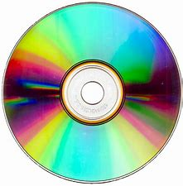
MPEG-1 Compression Algorithm
Designed for up to 1.5 Mbit/sec
Standard for the compression of moving pictures and audio
This was based on CD-ROM video applications, and is a popular standard for video on the Internet, transmitted as .mpg files.

Slide 9
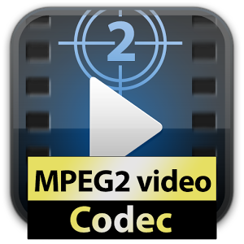
MPEG-2 Compression Algorithm
Designed for between 1.5 and 15 Mbit/sec
Standard on which Digital Television set top boxes and DVD compression is based.
It is based on MPEG-1, but designed for the compression and transmission of digital broadcast television.

Slide 10
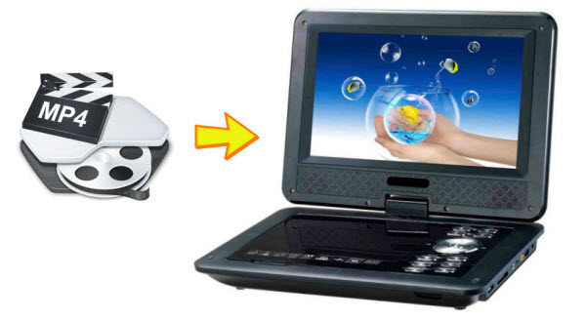
MPEG-4 Compression Algorithm
Standard for multimedia and Web compression
An interoperable cross-platform ecosystem
It also allows developers to control objects independently in a scene, and therefore introduce interactivity
Designed for all digital multimedia platforms

Slide 11


Media File Architecture
A digital or multimedia architecture is a methodology for the creation, storage, delivery and playback of digital media forms or types, like movies
QuickTime is an architecture, as was Video for Windows (now Windows Media)
For the web, QuickTime and RealMedia are very popular architectures.

Slide 12
Compressor/Decompressor
Within a Media Architecture are various algorithms that can be used to compress and decompress media files
These are called Compressor/Decompressor - CODECs
A CODEC is used to compress a media file, eliminating redundant data
A CODEC is also used to decompress the file and play it on an end user's computer

Slide 13
Common Video File Formats
Quicktime
The QuickTime format is developed by Apple
QuickTime is a common format on the Internet, but QuickTime movies cannot be played on a Windows computer without an extra (free) component installed
Videos stored in the QuickTime format have the extension .mov
Windows Media format
The Windows Media format is developed by Microsoft
Windows Media is a common format on the Internet, but Windows Media movies cannot be played on non-Windows computer without an extra (free) component installed
Videos stored in the Windows Media format have the extension .wmv

Slide 14
Common Video File Formats
The MPEG Format
The MPEG (Moving Pictures Expert Group) format is the most popular format on the Internet.
It is cross-platform, and supported by all the most popular web browsers.
Videos stored in the MPEG format have the extension .mpg or .mpeg
The AVI Format
The AVI (Audio Video Interleave) format was developed by Microsoft.
The AVI format is supported by all computers running Windows, and by all the most popular web browsers.
It is a very common format on the Internet, but not always possible to play on non-Windows computers.
Videos stored in the AVI format have the extension .avi.

Slide 15

Common Video File Formats
RealVideo Format
The RealVideo format was developed for the Internet by Real Media.
The format allows streaming of video (on-line video, Internet TV) with low bandwidths. Because of the low bandwidth priority, quality is often reduced.
Videos stored in the RealVideo format have the extension .rm or .ram.
The Shockwave (Flash) Format
The Shockwave format was developed by Macromedia, now owned by Adobe
The Shockwave format requires an extra component to play.
This component comes preinstalled with the latest versions of Chrome, Firefox and Edge.
Videos stored in the Shockwave format have the extension .swf.
Note that Flash will no longer be supported after December 2020.

Slide 16
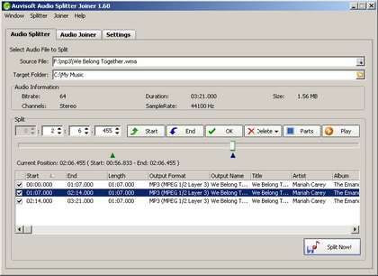
Audio File Size
Audio file size is determined by a combination of:
Sample rate
Bit depth
Number of channels
Length in minutes

Slide 17
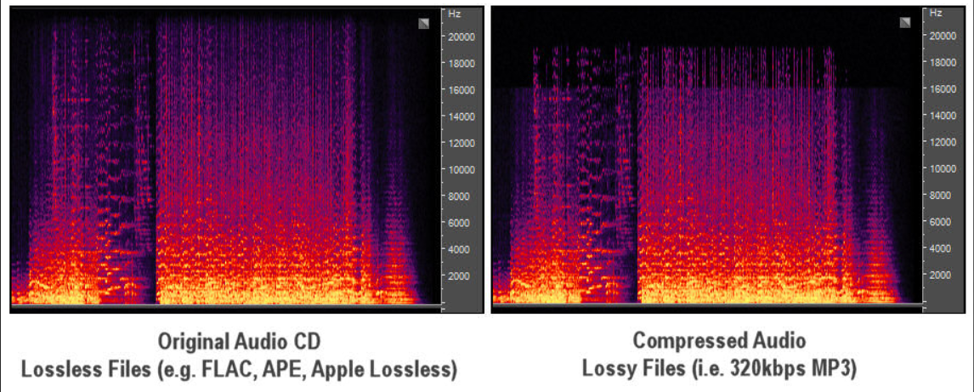
Audio Compression
Lossless Audio Compression
Removes redundant data
Resulting signal is same as original – perfect reconstruction
Lossy Audio Encoding
Removes irrelevant data
Resulting signal is similar to original

Slide 18
MPEG Audio Compression
Physically Lossy compression algorithm
Perceptually lossless, transparent algorithm
Exploits perceptual properties of human ear
Psychoacoustic modeling
MPEG Audio Standard ensures inter-operability, defines coded bit stream syntax, defines decoding process and guarantees decoder’s accuracy.
No assumptions about the nature of the audio source
Exploitation of human auditory system perceptual limitations
Removal of perceptually irrelevant parts of audio signal
It offers a sampling rate of 32, 44.1 and 48 kHz

Slide 19
Audio File Formats - uncompressed
.wav
Standard audio file format used mainly in Windows PCs
Commonly used for storing uncompressed (PCM), CD-quality sound files, which means that they can be large in size - around 10MB per minute of music
aiff
the standard audio file format used by Apple
The audio data in a standard .aiff file are uncompressed
Like any non-compressed, lossless format, it uses much more disk space than MP3

Slide 20
Audio Files Format - compressed
.mp3
Compressed file
MP3 is the most popular format for downloading and storing music
MP3 uses a lossy compression algorithm
.ogg
designed to greatly reduce the amount of data required to represent audio recordings.
Very similar to mp3, but also used for holding audio metadata, such as artist and track information.
.ra, .ram
Real Player format used for streaming audio files over the Internet
.au
the standard audio file format used by Sun, Unix and Java
The audio in au files can be PCM or compressed

Slide 21
Midi files
A file with the .MID or .MIDI file extension (pronounced as "mid-ee") is a Musical Instrument Digital Interface file. Unlike regular audio files like MP3s or WAVs, these don't contain actual audio data and are therefore much smaller in size.
MIDI is actually a protocol that enables computers, midi-keyboards, synthesizers and other digital musical instruments to communicate with each other.
Files in this format are basically instructions that explain how the sound should be produced once attached to a playback device or loaded into a particular software program that knows how to interpret the data.
This makes MIDI files perfect for sharing musical information between similar applications and for transferring over low-bandwidth internet connections, and storing on small devices; a common practice in early PC games.

Slide 22
What is XML, and why do we use it?
The Extensible Markup Language (short XML) is a markup language like HTML but is extensible. It was created by the World Wide Web Consortium (W3C) and defines rules for the construction of a document. XML adds context and structure to the information in a document. It does not say how the data should be displayed.
Some programs can get information out of an XML-document. To do that, they need an API (there are many APIs available for XML).
You can write a description of an XML document in a way that is useful for programmers. There are several languages for this; the best known is called DTD.

Slide 23
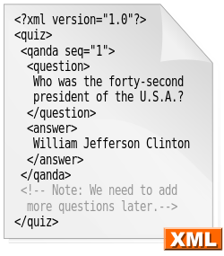
XML Syntax
XML uses less than (<) and greater than (>) to show tags. For example, a paragraph in HTML would be <p>.
A closing tag is a tag used to enclose the value of the tag. The tag has a slash (/) before its name. For example, </p>
A tag which is empty can be represented as an opening tag but with a slash before the >. For example, <p />

Slide 24
Writing XML
This form of computer programming transports and stores data as a text file but does not display it. For the data to display, XML must work in conjunction with another language such as PHP, JavaScript or HTML. Data, stored in a tree structure, uses elements designed and named by the person writing the document. Writing data into an XML file is a straightforward process; you can use any text editor.
Make your declaration at the top of the page. An XML declaration gives the program running your page instructions. A standard declaration starts with <?xml, lists the version and ends with a closing tag.
The declaration should always be the first line of any XML document.

Slide 25

Writing XML
The first step is to write the XML declaration, as follows. There are four parts to this -
We will then create the root element, which is the most important. Our XML file will store details of a music catalogue.
We can now go on to create the actual XML code.
All tags must have opening and closing elements.
All tags must be nested correctly.
All attribute values are quoted.
Empty elements must be formatted correctly.

Slide 26
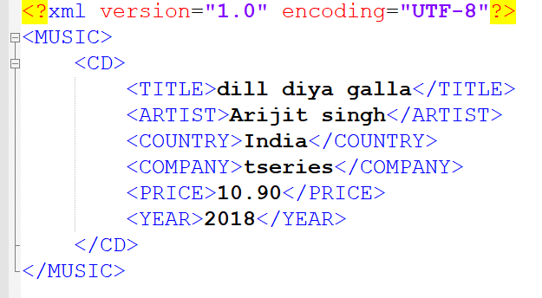
Writing XML
There must be one top-level root tag that encloses all the others – in this case <MUSIC>.
Tags can be nested, but always close first, the tag that you opened last, e.g here, <TITLE></TITLE> is nested inside <CD></CD>, which is in turn nested inside <MUSIC></MUSIC>
Tags are case sensitive – i.e. <MUSIC> is not the same thing as <Music>
Tags with other tags nested inside them, here <MUSIC></MUSIC> and <CD></CD> are sometimes called complex elements.

Slide 27
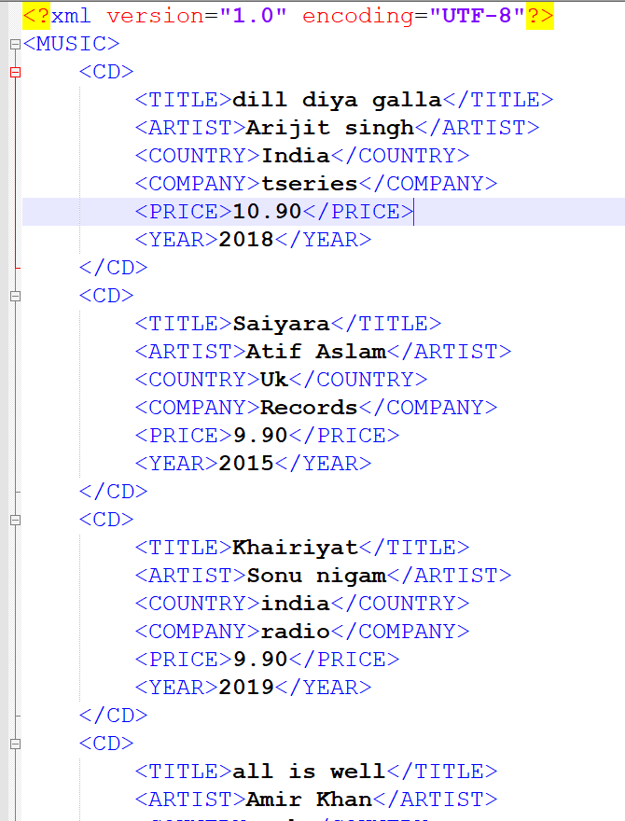
Validating XML
An XML document with an error in it is a dead document. Even omitting one closing bracket renders the whole document unreadable.
Just like HTML, it is therefore advisable to validate your XML using one of the many available online validator tools – such as https://www.xmlvalidation.com
XML without error and that can be rendered is called well-formed XML

Slide 28
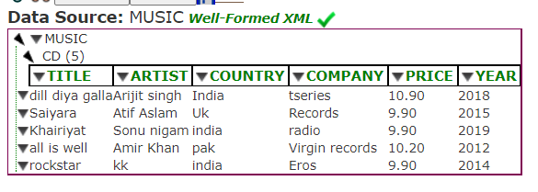
Visualizing XML
There are also online visualization tools that will display your XML data in a spreadsheet format, such as XML Reader/Editor Online - xmlGrid.net

Slide 29
Thanks For Watching

